Slide 1


Slide 2
Agenda
Project Team
Project Details
Executive Summary
High Level Approach
Project Scope
Project Output
Conclusion

Slide 3






Our Team
Ankur Mehta
Shwetank Nagar
Management Consultant
VP at Morgan Stanley
Experienced BI & DWH Specialist
Jairaj Shetty
Vikas Phatak
Oil & Gas Professional
Intermediate competencies – Python, R, SQL, Hadoop, Tableau
Techno-functional Consultant
Niranjanprasad Bhagwat
Gunnvant Singh
Manager – Crisil Ltd
Project SPOC

Slide 4
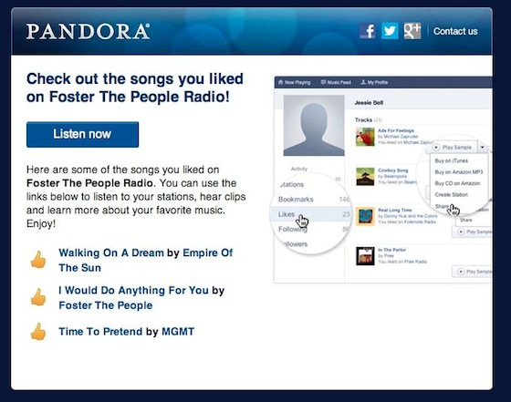
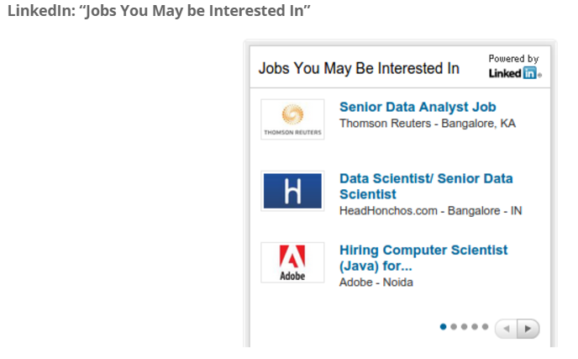
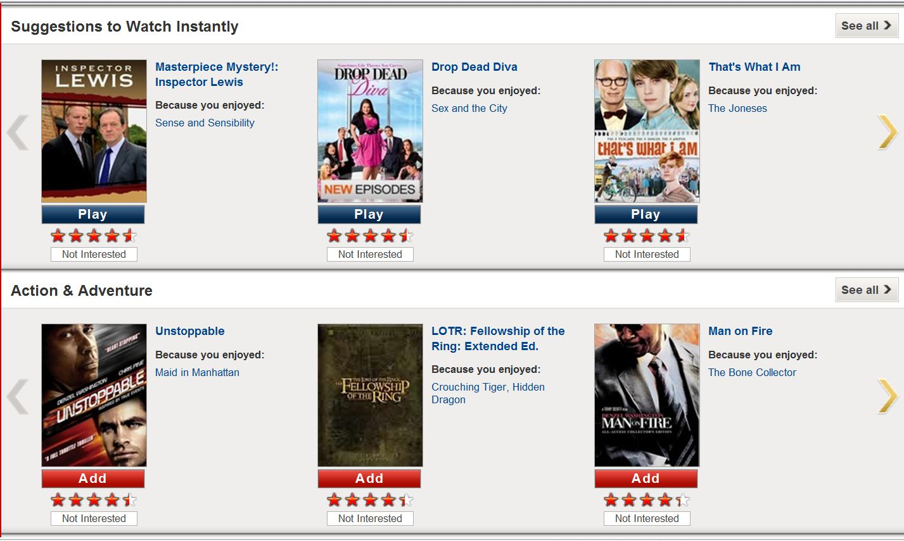
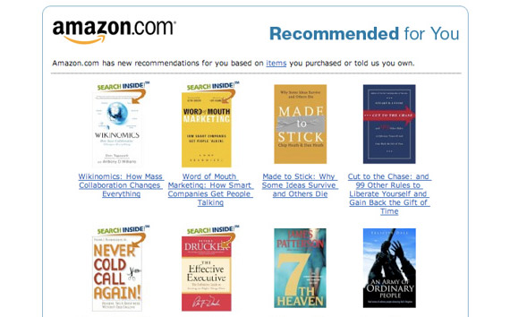
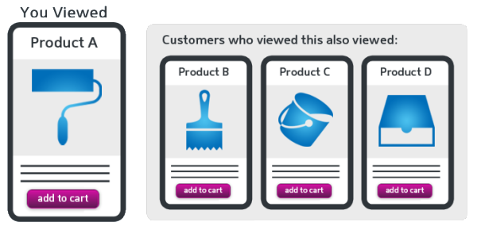
Recommendation Engine!
“Every marketer dreams to become the next
Pandora, Amazon or Netflix”
Notes:
When a user does a search online, he/she interacts with large catalogue of items - movies, news articles, etc. and have hundreds of thousands of items to select from. A lot of times, people don’t know what they want until you show it to them. This is where recommendation engine steps in. You must have come across recommendations, when looking for music, movies, books & even job hunting. These are few of those examples. This tool is so powerful that, every marketer dreams to become the next Pandora, Amazon or Netflix. And this is what our project is based on.. Pretty interesting!

Slide 5

Project Details
Summary:
Improve readership for news website, by recommending news articles specific to user’s tastes or preferences
Data Source:
2.5 lacs news article collected from 20-25 news sites
Client Details: Sidharth Shah, CEO
www.fafadiatech.com

Slide 6
Executive Summary
Evaluate different techniques – content based and collaborative filtering
For collaborative approach, challenge to receive quality data (ratings) from subscribers
In reality, following alternatives:
Frequency of visits to web pages
Pages visited/ clicked
Duration & time spent visiting specific pages
High level view of the solution
Enhance subscriber’s profile
Ad Targeting
Event triggers

Slide 7
Use Case & Stakeholders
Customer: Start-Up
E-commerce start-up offers service to curate articles per user preferences
Analytics Service Provider
Offers service to build a news recommendation engine
Uses data science to improve selection of relevant news articles, e.g. with different models
Generates revenue through advertisements
Beats the competition by increased readership
Helps improve readership with more relevant selections
Notes:
Narrative – how the ecosystem works – interdependence – how the analytics provider helps the customer

Slide 8
High Level Approach: SIPOC
Sources
News websites
Input
User profile
User ratings (Explicit & Implicit)
Process
See below
Output
Reco. engine
Top match articles
Customer
New Users
Nearest users (close to similar profile)
News articles
Users/ Subscribers
Front End Capture: User profile creation, Ratings & Click stream data
Back End Capture: Data clean-up, Web crawling
Algorithm Development: Content & Collaborative
Performance evaluation & Iterative Model improvement

Slide 9
Project Scope
Current Scope
Web crawling
Data cleaning
Content based & collaborative filtering
Model performance evaluation & iteration
Output top match articles & nearest user
Future Scope
Ratings based on frequency of visits to web pages, pages visited/ clicked and duration/ time spent visiting specific pages
Try new approaches, for performance optimization
Ensemble
Chaining & Combination
Collect more user data base and fine tune the recommendation engine

Slide 10
Data Exploration
Sources
News article time interval : Jul’16 –Aug’16
Highly right skewed with most articles from technology, finance & business domain

Slide 11
Data Exploration
Sources
From the standard news article categories, 14% articles are sub-categorized giving deeper insights in a particular domain
Out of 15K authors, top authors wrote 2.7K articles with top 10 authors wrote 1.8K average articles

Slide 12
User Profile
Input
Typical user profile, taking into account demographics, user preferences
Key input for collaborative filtering algorithm
Also, a con for collaborative filtering if user database is very small
New User - Registration
Demographic data capture
User creation
Display sub-categories to User
User selection of 3-5 preferred sub-categories
Save user preferences

Slide 13

User Rating
Input
Explicit Rating
Provide Initial articles, using demographic and sub-category preferences
User rates articles on 1-5 scale (5=best)
Capture User Rating
Simplicity
Rating’s: 0-5, Like or Not like
Doesn’t scale: Only few bother to leave reviews
Implicit Rating
Define criteria for clickstream data
Capture user browsing pattern
Define implicit user-article rating
Learn ratings from user actions
Hard implicit to learn low ratings, can’t learn if an user dislike
Most recommenders use combination - Explicit ratings used wherever available, but are supplemented by Implicit ratings

Slide 14
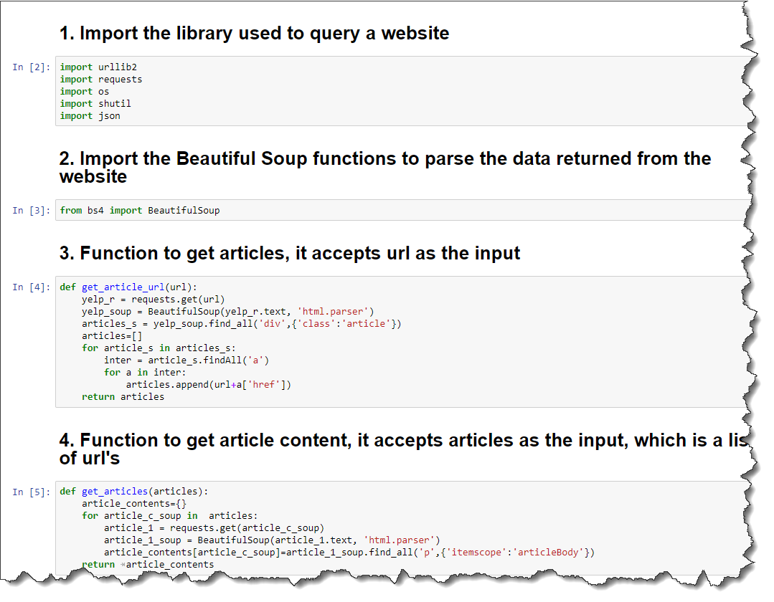
Web Crawling
Process
Web crawler/ spider automatically fetches contents of a web page, by indexing to certain search items
40 websites were crawled for this database
For regular update of the database, a scheduler using Apache Solr has been setup
Beautiful Soup/ Scrapy libraries were used
Prepare a list of news site URL’s
For each URL, get relevant HTML tags
Save source URL, time stamp, sub-categories, keywords, etc.
Capture article using tag (Beautiful Soup)
Save article text
Web Crawler
Code
World Wide Web
Web pages
Scheduler
URLs
Multi-threaded downloader
Text and metadata
Queue
URLs
Storage

Slide 15
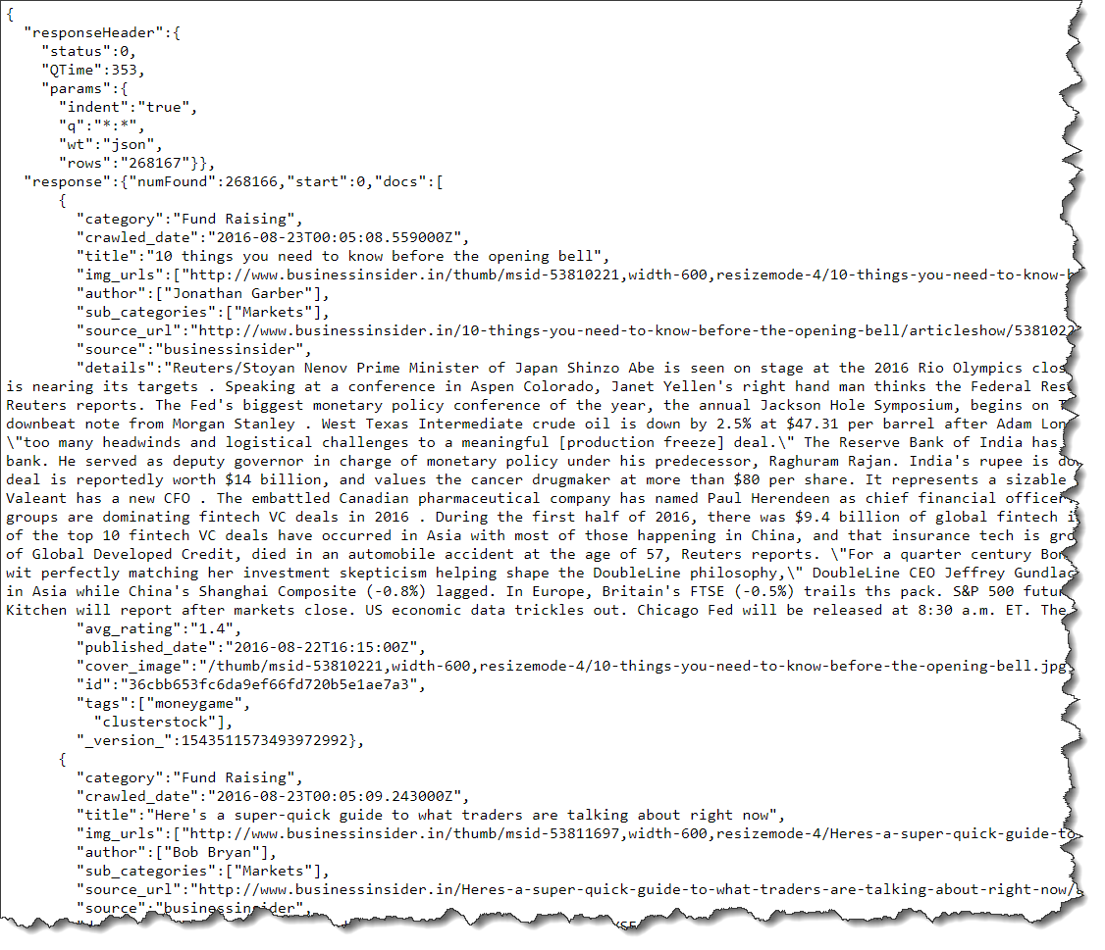
Data Cleaning
Process
Removal of expressions
Split attached words
Add cleaned text data to dictionary
Store dictionary
Import data
Escaping html characters
Decoding data
Apostrophe lookup
Approach followed to clean the database

Slide 16
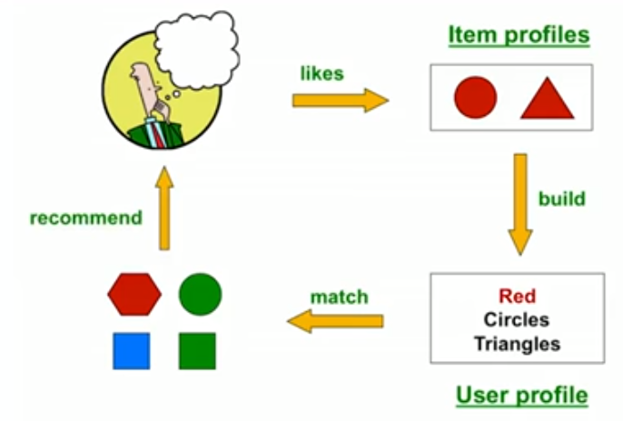
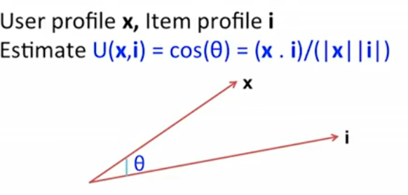
Content Based Approach
Process
Item Profile:
Set of “important” words in news articles
For text mining TF-IDF (Term frequency * Inverse Doc Frequency) was used
User Profile:
User has rated items with profile
Simple or Variant: (weighted) average of rated item profiles or normalize weights using average rating of user
Making Predictions:
As angle becomes smaller, X & I are similar and more likely to accept the recommendation
For X, we compute cosine similarity between that user and items in catalogue and recommend

Slide 17
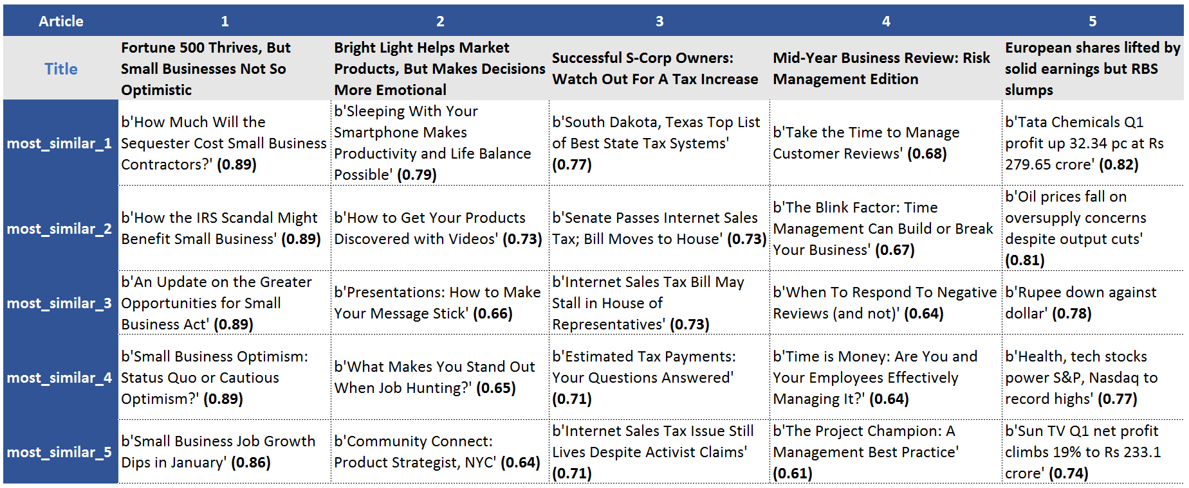
Content Based Approach
Process
News Article - Recommendation
Challenges
Cold start problem for new users
No user profile, as he has not rated
Most - starts new user with average profile, based on system based average and as things evolve
Similarity Range: -1 to 1
-1 : Exactly opposite
0 : Intermediate similarity/ Dissimilarity
1 : Exactly same

Slide 18
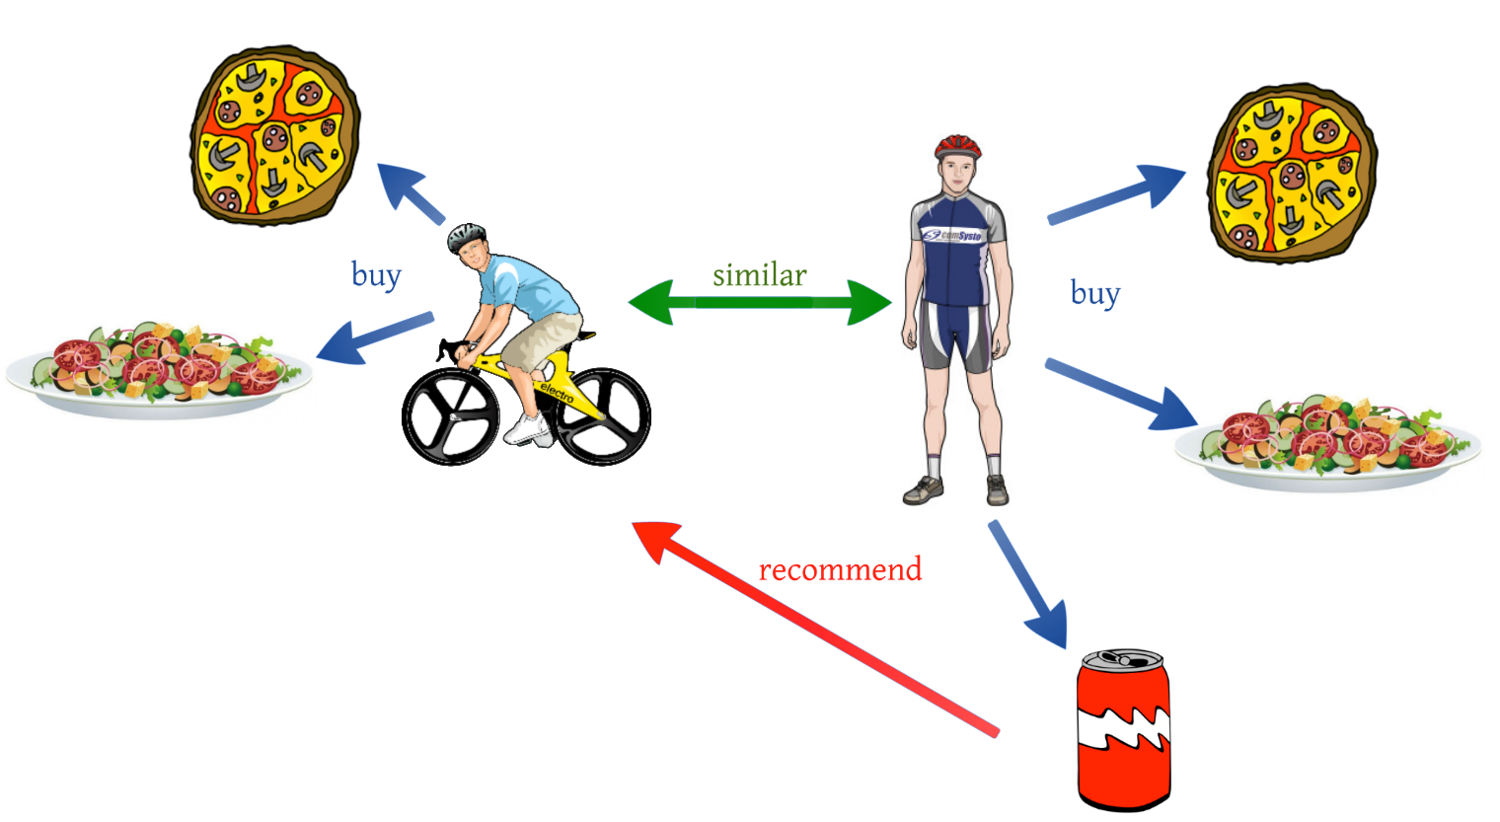
Collaborative Filtering Approach
Process
Find group of other users, who have similar tastes
Define notion of similarity between users and calculate Similarity Score
Jaccard Similarity/ Manhattan Distance
Euclidean Distance
Cosine Similarity
Centered cosine or Pearson Correlation
Find nearest neighbor
Estimate rating as the weighted average
Give recommendations!
User-User
Item-Item
Both are dual approaches, but item-item outperforms user-user in many use cases
Items are “simpler” than users
Items belong to small set of “genres”, users have varied tastes
Item Similarity is more meaningful than User Similarity

Slide 19
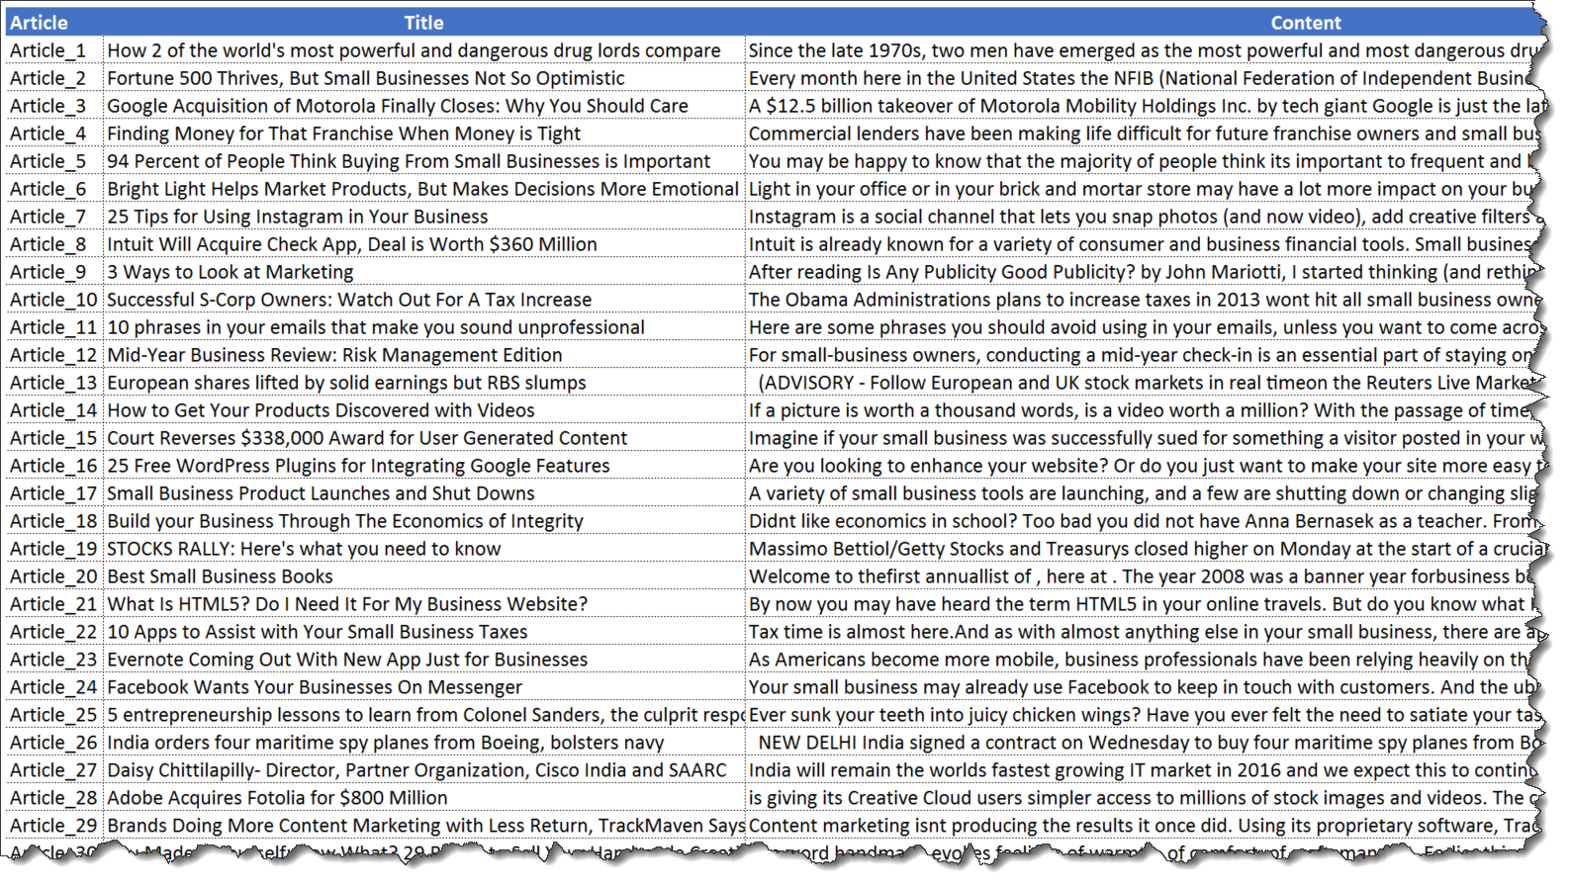
Collaborative Filtering Approach
Process
Challenges
Cold start problem, need enough users in the system to find a match
User/rating matrix is sparse, hard to find users that have rated similar items
Cannot recommend an unrated item, new items
News Articles

Slide 20
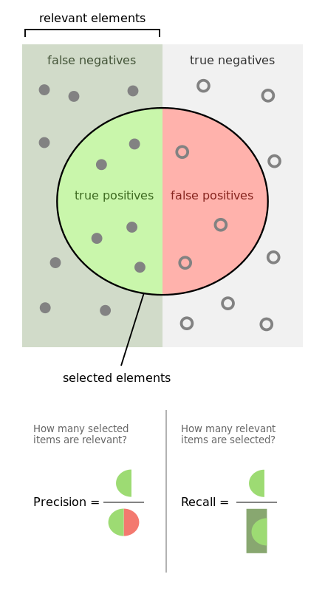


Model Evaluation: Methodology
Process
Theoretically confusion matrix is used to evaluate model performance
Precision: how precise is our recommendation
Recall: how well have we covered the universe of good articles
Trade-off: Reducing False Positives, results in an increase in False Negatives
Cut-off decision: If user prefers fewer articles, algorithm with better precision should be selected
If user prefers capturing all articles, algorithm with better recall to be picked
Ideally the engine should be tailored to user preferences

Slide 21
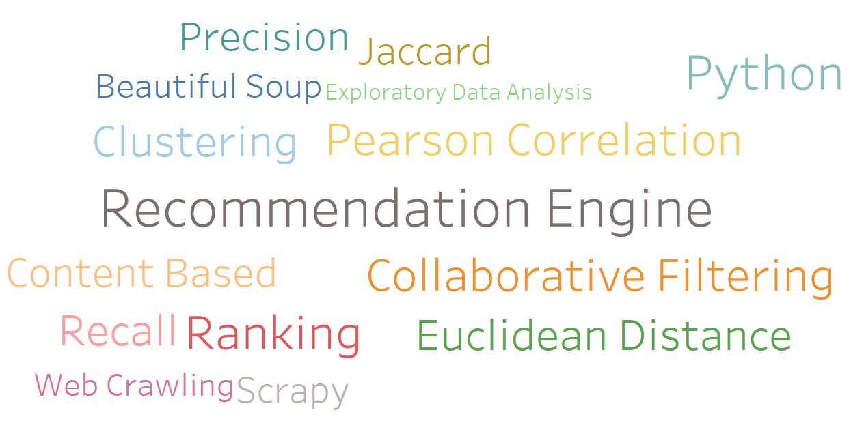
Project Output
Output
??

Slide 22
Conclusion
Content to Collaborative recommendations

Slide 23
References
Programming Collective Intelligence
- By Toby Segaran
Mining of Massive Datasets: Recommender Systems
- Standford University

Slide 24
Questions?

